Slide 1

Predictive Analytics for Social Media Virality
Aditi Shah
Anshika Khandelwal
Parth Marathe
Tanisha Dhopeshwar
Vinay Bhati
San Jose State University
DATA245 - Machine Learning Technologies
Prof Dr. Shih Yu. Chang
Notes:
Hello everyone, Today we will be presenting you all the demo for our project. The topic for our presentation is predictive analytics for social media virality. Before moving to our code ill give yall the gist about the problem statement
The ultimate goal is to predict the Annotations, which reflect the popularity and engagement level on Twitter. By leveraging the insights derived from the regression models, social media managers can optimize content strategies to maximize engagement.

Slide 2
Concepts
Problem Statement
About Dataset
Project Architecture
Data Preparation
Model Selection
Model Evaluation
Deployment
Conclusion

Slide 3
Problem Statement
This project aims to develop regression models to predict user attention levels on social media based on discussion characteristics such as the number of authors, discussion length, and discussion volume. The insights from these models will guide social media strategies to enhance user engagement over time.
Objective:
The objective of this project is to build regression models that predict social media user attention based on factors like the number of authors, discussion length, and discussion volume. By analyzing patterns in historical data, the project will derive insights to guide social media strategies, helping professionals optimize content timing and engagement practices for maximum impact.
Notes:
Ultimate Goal
The ultimate goal is to predict the Annotations, which reflect the popularity and engagement level on Twitter. By leveraging the insights derived from the regression models, social media managers can optimize content strategies to maximize engagement.

Slide 4
About Dataset
Overview: The dataset titled "Buzz Prediction on Twitter" includes 577,233 instances, each described by 77 features that represent various metrics of social media activity over time.
Key Metrics: Attributes include the number of created discussions (NCD), author increase (AI), attention levels (AS(NA) and AS(NAC)), burstiness level (BL), contribution sparseness (CS), author interaction (AT), number of authors (NA), average discussion length (ADL), and number of active discussions (NAD).
Purpose and Use: The dataset is designed for regression tasks to predict the mean number of active discussions, reflecting the popularity of topics on Twitter, and is suitable for analyzing trends in user engagement and interaction.
Notes:
The "Buzz Prediction on Twitter" dataset comprises 577,233 records and 77 attributes related to Twitter activity, including metrics like discussion counts, author metrics, and interaction levels. Designed for regression analysis, it aims to predict the average number of active discussions, reflecting topic popularity.

Slide 5
Project Flow
Data Collection and Exploration
Data Preprocessing
Feature Engineering
Model Selection and Training
Model Evaluation
Deployment
Notes:
Our project on predicting Twitter buzz follows a structured approach: **Data Collection and Exploration** to gather and examine the dataset; **Data Preprocessing** for cleaning and feature scaling; **Feature Engineering** to enhance predictive capabilities; **Model Selection and Training** to identify and train the best algorithms; **Model Evaluation** using metrics like RMSE or R^2 to test accuracy; and **Deployment** to integrate the model for real-time predictions and analysis, completing our predictive modeling lifecycle.

Slide 6
Data Preparation
Data Cleaning:
Missing Values: Checked for missing values in the dataset and there were no missing values found.
Computed average values for key metrics: Number of Created Discussions, Author Increase, Attention Level, Burstiness Level, Number of Atomic Containers, Number of Contributions, Contribution Sparseness, Author Interaction, Number of Authors, Average Discussions Length, Number of Discussions.
Notes:
First, we checked the dataset for any missing values. And there were no missing values found.
And then
Next, we focused on computing average values for the key metrics over time for all the metrics that Aditi just mentioned.
By computing these averages, we were able to simplify the dataset and prepare it for detailed data analysis.

Slide 7
Data Preparation
Feature Engineering:
Feature Selection: Created new columns for the average values of key metrics over time.
Selected newly created average metrics columns for correlation analysis.
Notes:
In our feature engineering process, we created new columns that represented the average values of the key metrics over the observation period to condense the data.
And used newly created average metrics columns to perform EDA.

Slide 8
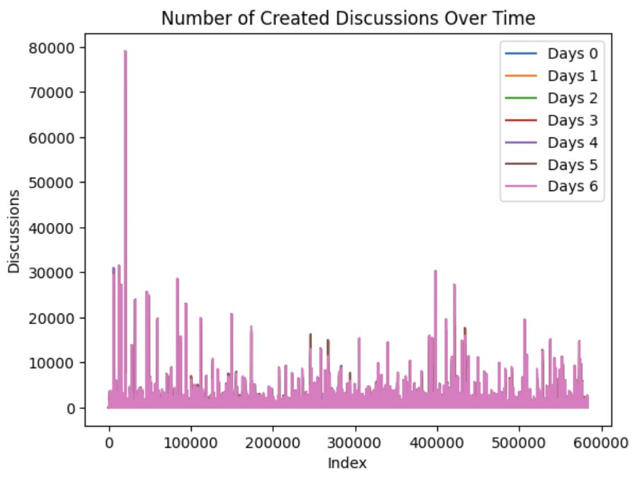
Data Exploration
Number of Created Discussions Over Time
Line plot showing the trend in the number of discussions created over seven days. The plot shows a consistent trend in discussion creation, with visible spikes indicating periods of high activity.
Notes:
Starting with the EDA part:
This line chart shows the trend in the number of discussions created over time for each week. The spikes represent periods of high activity, possibly due to trending topics or events.
This figure is useful for understanding the dynamics of discussions across different weeks, identifying peak discussion times, and potentially aligning them with external events.

Slide 9
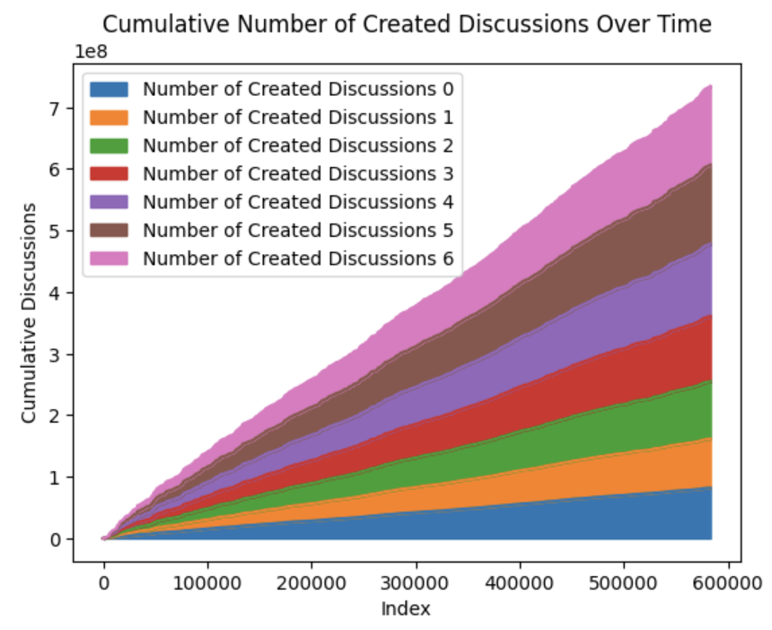
Cumulative Number of Created Discussions Over Time
The area plot visualizes the cumulative number of created discussions over time across seven days (Days 0 to 6). The plot shows a steady increase in cumulative discussions, indicating continuous engagement and interest in the topics discussed. Each layer represents the cumulative discussions for a specific day, and the colors distinguish the contributions of each day, demonstrating how discussions from different days accumulate over time.
Notes:
"This area plot visualizes the cumulative number of created discussions over a period of seven days."
"We can see a steady increase in the cumulative discussions, which indicates continuous engagement and growing interest in the topics being discussed."
"Each layer in the plot represents the cumulative discussions for a specific day, with different colors helping to distinguish the contributions of each day."
It is useful in understanding long-term engagement trends on Twitter. It highlights periods of high activity and sustained engagement.

Slide 10
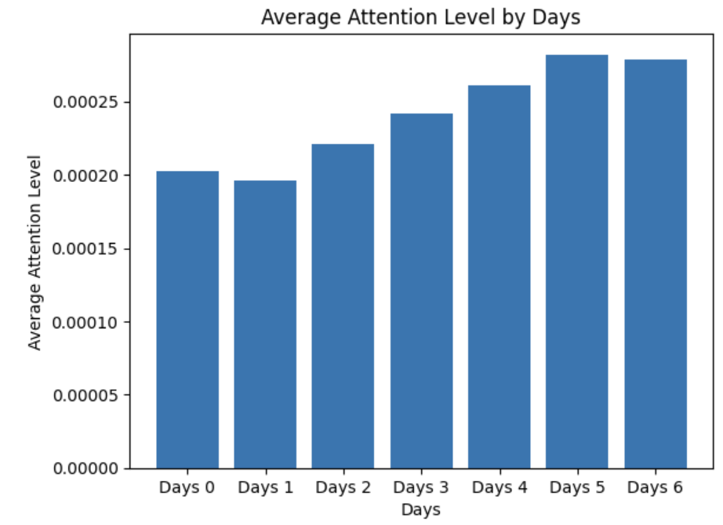
Average Attention Level by Days
The bar plot illustrates the average attention level over a week (Days 0 to 6). The plot reveals a general increasing trend in attention levels as the days progress, with Day 0 having the lowest average attention level and Day 6 having the highest. This suggests that discussions or topics tend to gain more attention as the week progresses, potentially due to the accumulation of content or the spread of information over time. The gradual rise in attention levels indicates that users might become more engaged as the week progresses, possibly due to increased activity or interest in ongoing discussions.
Notes:
"This bar plot shows the average attention level across seven days, from Day 0 to Day 6."
"We observe an increasing trend, with Day 0 having the lowest attention level and Day 6 the highest. This suggests that topics gain more attention as the week progresses."
"This increase might indicate that discussions build momentum over time, or it could reflect higher user engagement later in the week."

Slide 11
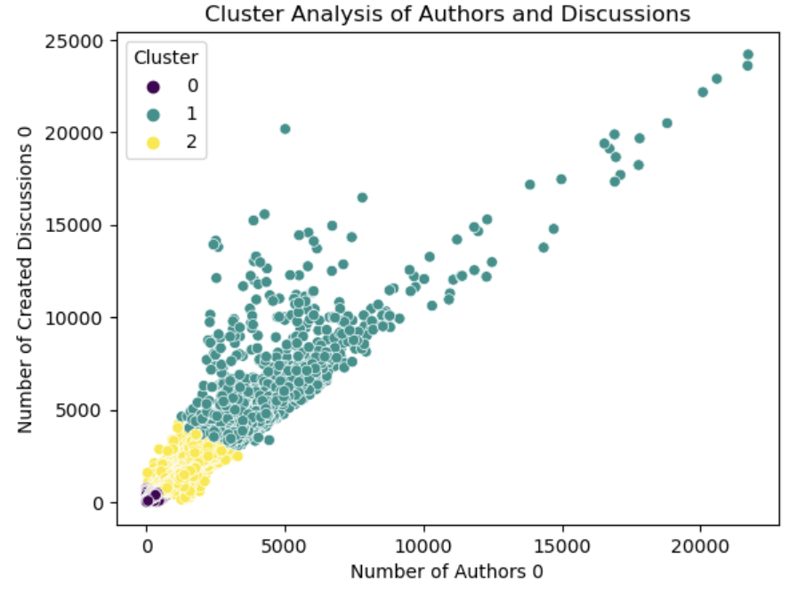
Cluster Analysis of Authors and Discussions
Scatter plot with KMeans clustering based on the number of authors and created discussions at Time 0.
Identified three distinct clusters representing different levels of topic popularity and engagement.
Understanding these clusters helps in targeting engagement strategies effectively, focusing on high-engagement clusters and developing strategies to boost lower-engagement ones.
Notes:
"This scatter plot shows the results of a cluster analysis based on the number of authors and created discussions at Time 0."
"The x-axis represents the number of authors participating, and the y-axis shows the number of created discussions."
"We have three clusters: Cluster 0 (yellow) with low numbers of authors and discussions,
Cluster 1 (purple) with moderate numbers,
and Cluster 2 (teal) with high numbers."
"There's a clear positive correlation between the number of authors and discussions, indicating that more authors lead to more discussions.

Slide 12
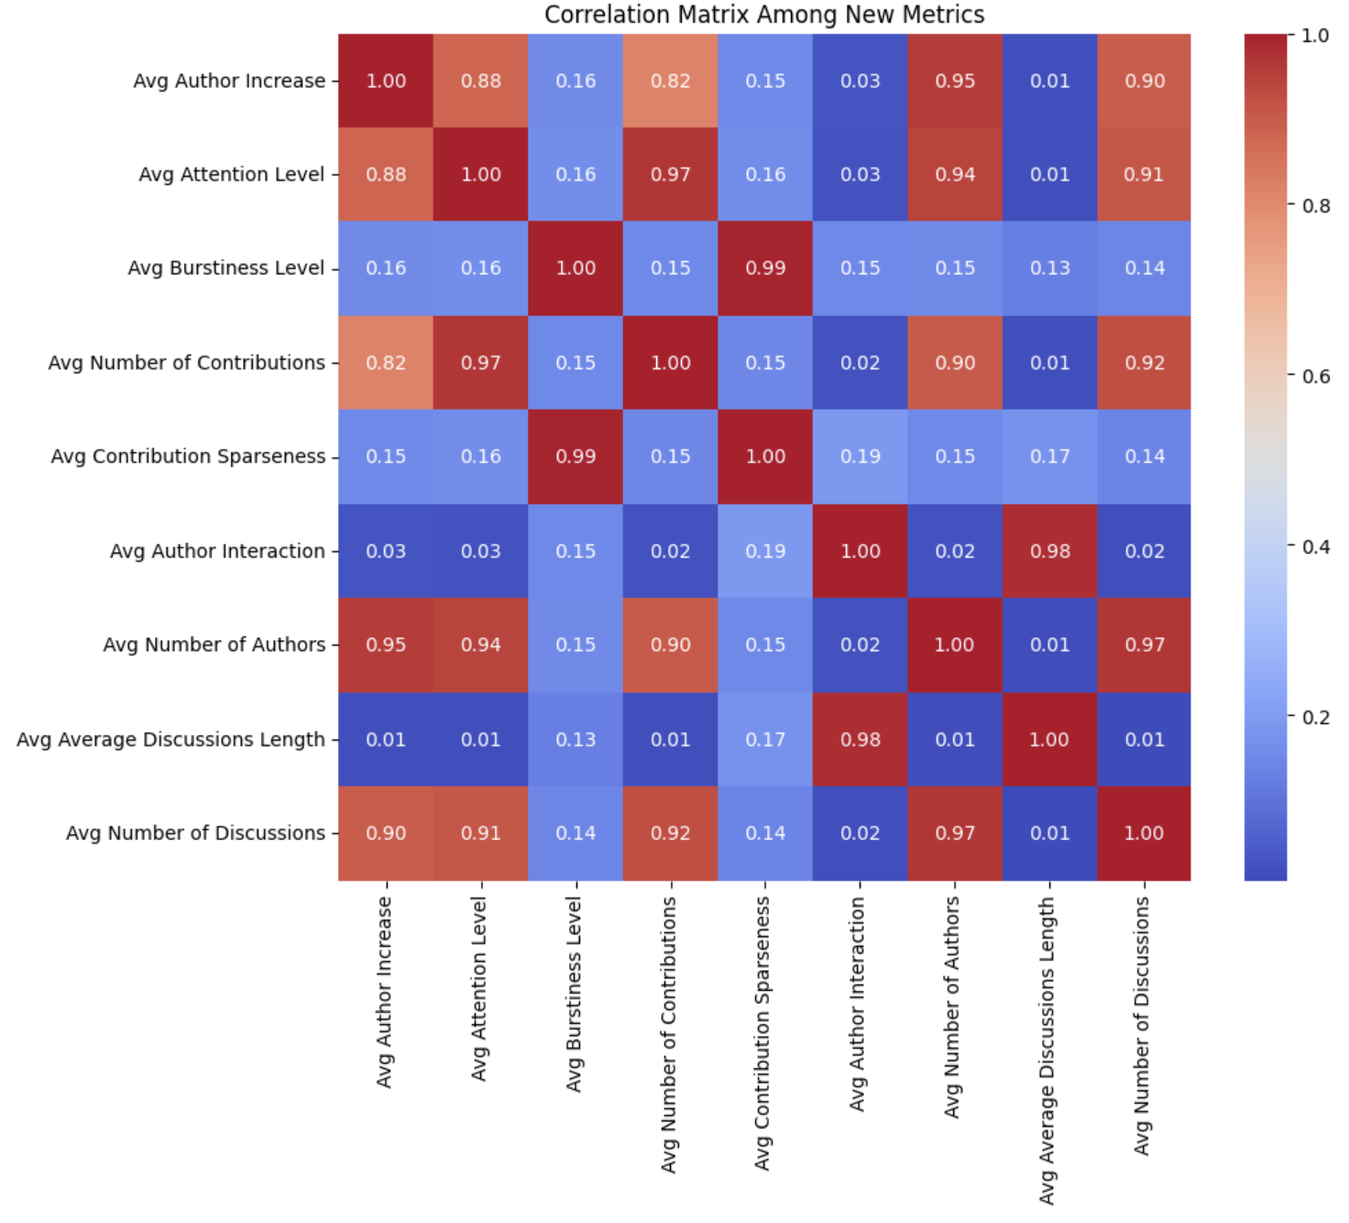
Correlation Matrix Among Averaged Metrics
Heatmap showing the correlation between average metrics such as Author Increase, Attention Level, Burstiness Level, etc.
High positive correlations between several metrics, indicating interdependencies, while some metrics like Author Interaction show weaker correlations.
Identifying strong correlations helps understand which metrics move together, aiding in strategic decision-making. Weak correlations indicate areas for targeted intervention.
Notes:
"This correlation matrix shows the correlation coefficients between different average metrics in our dataset."
"We see high positive correlations, such as between Avg Author Increase and Avg Attention Level with Avg Number of Contributions, suggesting these metrics move together."
"Metrics like Avg Author Interaction have low correlations with others, indicating they are influenced by different factors."
Important to identify key metrics influencing the buzz of a topic."

Slide 13
Model Selection
Bagging Models
Bagging, or Bootstrap Aggregating, is a machine learning ensemble technique designed to improve the stability and accuracy of machine learning algorithms used in classification and regression.
Typically, it involves training multiple models on different subsets of the dataset, then averaging the predictions to achieve a more generalized model.
Each model is built independently providing a way to reduce errors primarily by reducing variance.
Notes:
Bagging Models
Definition: Bagging, or Bootstrap Aggregating, is a machine learning ensemble technique designed to improve the stability and accuracy of machine learning algorithms used in statistical classification and regression.
How It Works: It reduces variance and helps to avoid overfitting. Typically, it involves training multiple models on different subsets of the dataset, then averaging the predictions to achieve a more generalized model.
Key Point: Each model is built independently providing a way to reduce errors primarily by reducing variance.
Example: Common algorithms include Random Forests and Bagging with decision trees, linear regression models.

Slide 14
Model Selection
Ridge Regression (Bagging)
Regularization technique used to analyze multiple regression data that suffer from multicollinearity.
Adds a degree of bias to the regression estimates, which reduces model complexity and prevents overfitting.
Strengths:
Reduces model complexity and overfitting.
Better generalization for predicting outcomes on unseen data.
Strengths of Model Regarding This Application:
Efficient at handling noise in large social media data.
Can stabilize predictions across highly correlated inputs common in social media metrics.
Rationale: Chosen for its ability to perform well in situations with high feature correlation and when the dataset is large.
Notes:
Ridge Regression (Bagging)
What the Model Is: Ridge Regression is a regularization technique used to analyze multiple regression data that suffer from multicollinearity (independent variables are highly correlated). It includes a penalty term to the loss function (L2 regularization).
How the Model Works: By adding a degree of bias to the regression estimates, it reduces model complexity and prevents overfitting. This is achieved by adding the squared magnitude of coefficient as a penalty term to the loss function.
Strengths of the Model:
Reduces model complexity and overfitting.
Better generalization for predicting outcomes on unseen data.
Strengths of Model Regarding This Application:
Efficient at handling 'noise' in large social media data.
Can stabilize predictions across highly correlated inputs common in social media metrics (like likes, shares, and comments).
Rationale & Why We Chose This Model:
Chosen for its ability to perform well in situations with high feature correlation and when the dataset is large, which is typical in social media analytics.
ridge = Ridge(alpha=0.1)bag_reg = BaggingRegressor(ridge, n_estimators = 100, max_samples= 500, n_jobs = -1, random_state=0)

Slide 15
Model Selection
Lasso Regression (Bagging)
Type of linear regression that uses shrinkage. Shrinkage is where data values are shrunk towards a central point, like the mean.
Lasso helps in feature selection by reducing the coefficients of less important features to zero, effectively removing them from the equation.
Strengths:
Performs feature selection automatically, which is useful for models with many variables.
Can handle multicollinearity and model complexity by eliminating irrelevant features.
Strengths of Model Regarding This Application:
Helps in identifying key features that contribute most to social media post virality.
Rationale: The feature selection capability makes it suitable for processing social media data where many features might be sparse or irrelevant.
Notes:
Lasso Regression (Bagging)
What the Model Is: Lasso Regression is another type of linear regression that uses shrinkage. Shrinkage is where data values are shrunk towards a central point, like the mean. It includes an L1 penalty to reduce some coefficients to zero.
How the Model Works: Lasso helps in feature selection by reducing the coefficients of less important features to zero, effectively removing them from the equation.
Strengths of the Model:
Performs feature selection automatically, which is useful for models with many variables.
Can handle multicollinearity and model complexity by eliminating irrelevant features.
Strengths of Model Regarding This Application:
Helps in identifying key features that contribute most to social media post virality.
Rationale & Why We Chose This Model:
The feature selection capability makes it suitable for processing social media data where many features might be sparse or irrelevant.
lasso = Lasso(alpha=0.01)
bag_reg_lasso = BaggingRegressor(lasso, n_estimators = 100, max_samples= 500, n_jobs = -1, random_state=0)

Slide 16
Model Selection
Boosting Models
Boosting is a family of machine learning algorithms that convert weak learners to strong ones..
It focuses on examples that are hard to predict, by iteratively adjusting the weights of the training samples. Each subsequent model attempts to correct the errors of the previous models.
Models are built sequentially to minimize the errors from previous models and the final prediction is a weighted average of all models.
Notes:
Boosting Models
Definition: Boosting is a family of machine learning algorithms that convert weak learners to strong ones. A weak learner is defined as a classifier that is only slightly correlated with the true classification.
How It Works: It focuses on examples that are hard to predict, by iteratively adjusting the weights of the training samples. Each subsequent model attempts to correct the errors of the previous models.
Key Point: Models are built sequentially to minimize the errors from previous models and the final prediction is a weighted average of all models.
Example: Popular boosting algorithms include AdaBoost, Gradient Boosting, and XGBoost.

Slide 17
Model Selection
Decision Tree with AdaBoost (Boosting)
AdaBoost, or Adaptive Boosting, is a boosting technique used to boost the performance of decision trees. It works by combining multiple weak learners into a single strong learner.
AdaBoost changes the weights of incorrectly classified instances so that subsequent classifiers focus more on difficult cases.
Strengths:
Improves the accuracy of simple models and reduces bias and variance.
Very flexible and requires little preprocessing.
Strengths of Model Regarding This Application:
Good at capturing complex interaction structures typically seen in social media data.
Rationale: Selected for its ability to enhance the performance of basic decision trees by focusing on harder-to-classify instances.
Notes:
Decision Tree with AdaBoost (Boosting)
What the Model Is: AdaBoost, or Adaptive Boosting, is a boosting technique used to boost the performance of decision trees. It works by combining multiple weak learners into a single strong learner.
How the Model Works: AdaBoost changes the weights of incorrectly classified instances so that subsequent classifiers focus more on difficult cases.
Strengths of the Model:
Improves the accuracy of simple models and reduces bias and variance.
Very flexible and requires little preprocessing.
Strengths of Model Regarding This Application:
Good at capturing complex interaction structures typically seen in social media data.
Rationale & Why We Chose This Model:
Selected for its ability to enhance the performance of basic decision trees by focusing on harder-to-classify instances, often seen in the nuanced world of social media trends.
Applications of the Model:
Used in customer segmentation, credit scoring, and other classification tasks where precision is crucial.
adatree = AdaBoostRegressor(dtree, n_estimators = 100, learning_rate= 0.5, random_state=0)

Slide 18
Model Selection
Linear Regression with AdaBoost (Boosting)
It applies the AdaBoost boosting technique to linear regression models to improve their prediction accuracy under variance.
It sequentially applies a linear regression model to repeatedly modified versions of the data, increasing the focus on cases where the previous models performed poorly.
Strengths:
Enhances the performance of linear regression by reducing variance without making the model overly complex.
Strengths of Model Regarding This Application:
Useful when trying to predict numerical outcomes which can be predicted based on linear tendencies.
Rationale: Chosen for its straightforward interpretation and improved handling of outliers and variance, which are common in viral content analysis.
Notes:
Linear Regression with AdaBoost (Boosting)
What the Model Is: It applies the AdaBoost boosting technique to linear regression models to improve their prediction accuracy under variance.
How the Model Works: It sequentially applies a linear regression model to repeatedly modified versions of the data, increasing the focus on cases where the previous models performed poorly.
Strengths of the Model:
Enhances the performance of linear regression by reducing variance without making the model overly complex.
Strengths of Model Regarding This Application:
Useful when trying to predict numerical outcomes like the number of shares or likes, which can be predicted based on linear tendencies.
Rationale & Why We Chose This Model:
Chosen for its straightforward interpretation and improved handling of outliers and variance, which are common in viral content analysis.
Applications of the Model:
Used in economics, sales forecasting, and resource allocation, where trend prediction is vital.
adatree = AdaBoostRegressor(lreg, n_estimators = 100, learning_rate= 0.5, random_state=0)

Slide 19
Model Selection
XGBoost
It is an implementation of gradient boosted decision trees designed for speed and performance.
XGBoost systematically refines its models, focusing on correcting the mistakes of the previous trees built and combines them into a strong learner.
Strengths:
High performance and speed, can handle large datasets efficiently.
Provides built-in support for regularization to avoid overfitting.
Strengths of Model Regarding This Application:
Capable of handling diverse and complex data structures, delivering high predictive accuracy.
Rationale: Opted for its robustness and scalability, essential for the dynamic and vast nature of social media datasets.
Notes:
XGBoost
What the Model Is: XGBoost stands for eXtreme Gradient Boosting. It is an implementation of gradient boosted decision trees designed for speed and performance.
How the Model Works: XGBoost systematically refines its models, focusing on correcting the mistakes of the previous trees built and combines them into a strong learner.
Strengths of the Model:
High performance and speed, can handle large datasets efficiently.
Provides built-in support for regularization to avoid overfitting.
Strengths of Model Regarding This Application:
Capable of handling diverse and complex data structures typical in social media data, delivering high predictive accuracy.
Rationale & Why We Chose This Model:
Opted for its robustness and scalability, essential for the dynamic and vast nature of social media datasets.
Applications of the Model:
Extensively used in competitive machine learning and in industries for critical applications such as fraud detection and predictive maintenance
gbrt = GradientBoostingRegressor(max_depth=3, random_state=0)
param_grid = {'n_estimators': [100, 200], 'learning_rate':[0.5, 1.0]}

Slide 20
Model Selection
Principal Component Analysis (PCA)
Purpose of PCA: Dimensionality reduction while retaining variance, Simplifies dataset for better analysis
Process: Standardized features, Applied PCA retaining 95% variance, Reduced 77 features to 18 principal components
Benefits: Reduced complexity, Identification of influential features
Results: PC1 heavily influenced by Number of Created Discussions and Author Increase
Notes:
1. Purpose of PCA:
"The primary goal of PCA, or Principal Component Analysis, is to reduce the dimensionality of our dataset. This means we're transforming our original set of features into a smaller set that still retains most of the information, or variance, present in the data. By doing this, we make our data easier to visualize and analyze, especially when dealing with high-dimensional data like ours."
2. Process:
"To start, we standardized the features. Standardization ensures that all our features have a mean of zero and a standard deviation of one. This step is crucial because PCA is sensitive to the variances of the original features, and we want to make sure each feature contributes equally."
"Next, we applied PCA to our standardized data. We decided to retain 95% of the variance, which is a good balance between simplification and retaining important information. This process reduced our original 77 features down to 18 principal components."
3. Benefits:
"The immediate benefit of PCA is the reduction in complexity. Instead of working with 77 features, we now only need to consider 18 principal components. This makes our data much more manageable."
"Additionally, PCA helps us visualize and interpret our data more easily. With fewer dimensions, we can create clearer plots and graphs."
"Lastly, PCA helps us identify the most influential features in our dataset. By looking at which original features contribute most to the principal components, we can better understand what drives social media virality."
4. Results:
"Our first principal component, or PC1, captures the highest amount of variance in the dataset. When we examined the loadings, we found that features like the Number of Created Discussions and Author Increase had high contributions to PC1. This indicates that these features are particularly important in explaining the variability in our data."
"To help visualize these results, we created a heatmap of the loadings. This heatmap shows us how much each original feature contributes to each principal component."
5. Visualization:
"Here we have a heatmap that visualizes the feature contributions to the principal components. The darker colors represent higher contributions. This visual tool helps us quickly see which features are most influential for each principal component."
[Point to the heatmap on the slide]
6. Key Takeaways:
"To summarize, PCA was crucial for effectively reducing the dimensionality of our dataset. By simplifying our data, we didn't lose significant information, making it easier to handle and analyze."
"Moreover, PCA allowed us to identify key features that significantly influence social media virality, such as the number of discussions and author interactions. This insight is invaluable for understanding what drives content to go viral on social media platforms."

Slide 21
Model Selection
LinearSVR (PCA)
Linear Support Vector Regression (SVR) is a type of support vector machine that performs linear regression in a high-dimensional space.
Strengths:
Capable of handling large feature spaces.
Provides a unique solution due to the convex nature of the optimization problem.
Strengths of Model Regarding This Application:
Effective at capturing linear relationships within social media data.
Suitable for datasets with a large number of features after PCA.
Rationale:
Chosen for its ability to perform linear regression in high-dimensional spaces, which is beneficial after dimensionality reduction with PCA.
Handles large datasets efficiently, making it suitable for social media analytics.
Notes:
Speaker Notes:
Welcome to the model selection section of my presentation on Social Media Virality Prediction. First, let's discuss Linear Support Vector Regression (SVR) with PCA.
Description:
Linear SVR is a support vector machine adapted for linear regression, particularly effective in high-dimensional spaces.
Strengths:
This model can handle extensive feature spaces and offers a unique solution due to the convex nature of its optimization.
Application to Social Media Virality:
In the context of social media data, Linear SVR effectively captures linear relationships.
It's particularly suitable for our dataset, which has numerous features even after PCA transformation.
Rationale:
We chose Linear SVR for its efficiency in handling high-dimensional data, crucial for our extensive social media metrics.
It scales well with large datasets, ensuring robust and scalable predictions.

Slide 22
Model Selection
KernelSVR (PCA)
Kernel Support Vector Regression (SVR) extends SVR by applying the kernel trick, enabling it to model nonlinear relationships.
Strengths:
Can model complex nonlinear relationships.
Uses kernel functions to transform data into higher dimensions.
Strengths of Model Regarding This Application:
Potential to capture complex patterns in social media interactions.
Flexible in handling various types of data distributions in social media metrics.
Rationale:
Chosen for its ability to handle nonlinear relationships, which can be present in social media data after PCA transformation.
Provides flexibility in capturing intricate patterns in the data.
Notes:
Speaker Notes:
Next, we have Kernel Support Vector Regression (SVR) with PCA.
Description:
Kernel SVR extends the linear SVR by incorporating the kernel trick, allowing it to capture nonlinear relationships.
Strengths:
It's capable of modeling complex nonlinear interactions and transforming data into higher dimensions using kernel functions.
Application to Social Media Virality:
Kernel SVR is particularly useful for capturing intricate and complex patterns in social media interactions.
It adapts well to various data distributions, making it versatile for our analysis.
Rationale:
We chose Kernel SVR due to its strength in modeling nonlinear relationships, crucial for capturing the dynamics of social media virality.
This flexibility allows us to uncover deeper patterns in our data, providing more accurate predictions.

Slide 23
Model Selection
KNN Regression (PCA):
Description: Predicts target variable based on the k-nearest training samples in feature space.
Strengths:
Simple to implement.
No assumptions about data distribution.
Application to Social Media Virality Prediction:
Effective for datasets with local structure post-PCA.
Adapts to different scales and distributions of social media data.
Rationale: Chosen for simplicity and capturing local relationships. Suitable for non-parametric modeling.
Notes:
Speaker Notes:
Now, let's look at K-Nearest Neighbors (KNN) Regression with PCA.
Description:
KNN regression predicts the target variable by averaging the outcomes of the k-nearest neighbors in the feature space.
Strengths:
It's straightforward to implement and doesn't make any assumptions about the underlying data distribution.
Application to Social Media Virality:
KNN is effective for datasets with local structures, which is often the case after PCA.
It can adapt to different scales and data distributions, making it flexible for our social media data.
Rationale:
We selected KNN for its simplicity and ability to capture local relationships within the data.
Its non-parametric nature allows it to perform well without strict assumptions, which is beneficial for the varied nature of social media metrics.

Slide 24
Model Selection
Polynomial Regression (PCA):
Description: Models relationship as an nth degree polynomial.
Strengths:
Models nonlinear relationships with polynomial terms.
Fits a wide range of curves to the data.
Application to Social Media Virality Prediction:
Captures quadratic relationships in social media interactions post-PCA.
Fits data with polynomial-like distributions well.
Rationale: Chosen for modeling nonlinear relationships common in social media data. Balances complexity and predictive power.
Notes:
Description:
Polynomial regression extends linear regression by fitting an nth degree polynomial to the data, capturing more complex relationships.
Strengths:
It models nonlinear relationships effectively using polynomial terms.
This model can fit a wide range of curves, making it adaptable to various data patterns.
Application to Social Media Virality:
In our application, polynomial regression is useful for capturing quadratic relationships in social media interactions.
It fits well with data that exhibits polynomial-like distributions, which is common in social media metrics.
Rationale:
We chose Polynomial Regression for its ability to model the nonlinear relationships prevalent in social media data.
It provides a balance between complexity and predictive power, making it a strong candidate for our analysis.

Slide 25
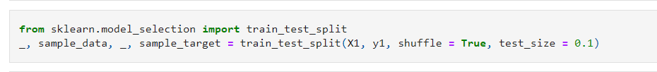
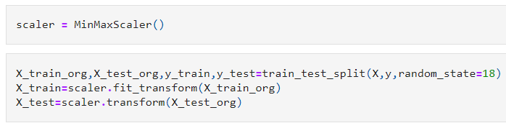
Model Training
Split Data into Training and Testing
Performed Scaling of features
Notes:
For boosting models
Chose param grid
Configured GRid search cv
Trained the model on best parameter

Slide 26
Evaluation
WITHOUT PCA
Model Name | Model Parameter | Train Accuracy | Test Accuracy
KNN | k = 3 | 0.893 | 0.908
Linear Reg | - | 0.957 | 0.952
SGD Reg | max_iter=10000, penalty=L2 | -2.930e+06 | -3.476e+06
Polynomial | - | 0.981 | 0.024
Ridge | alpha=0.00001 | 0.957 | 0.952
Lasso | alpha=0.005 | 0.957 | 0.953
Linear SVM | C=1000, gamma=0.01 | 0.710 | 0.731
Kernel SVM | C=1000, gamma=0.02, epsilon=10 | 0.891 | 0.897

Slide 27
Evaluation
WITH PCA
Model Name | Model Parameter | Train Accuracy | Test Accuracy
KNN | k = 3 | 0.931 | 0.811
Linear Reg | - | 0.751 | 0.740
SGD Reg | max_iter=10000, penalty=L2 | 0.855 | 0.837
Polynomial | - | 0.878 | -1.337
Ridge | alpha=0.00001 | 0.855 | 0.835
Lasso | alpha=0.005 | 0.855 | 0.835
Linear SVM | C=1000, gamma=0.01 | 0.710 | 0.731
Kernel SVM | C=10, gamma=0.1, epsilon=10 | 0.831 | 0.824

Slide 28
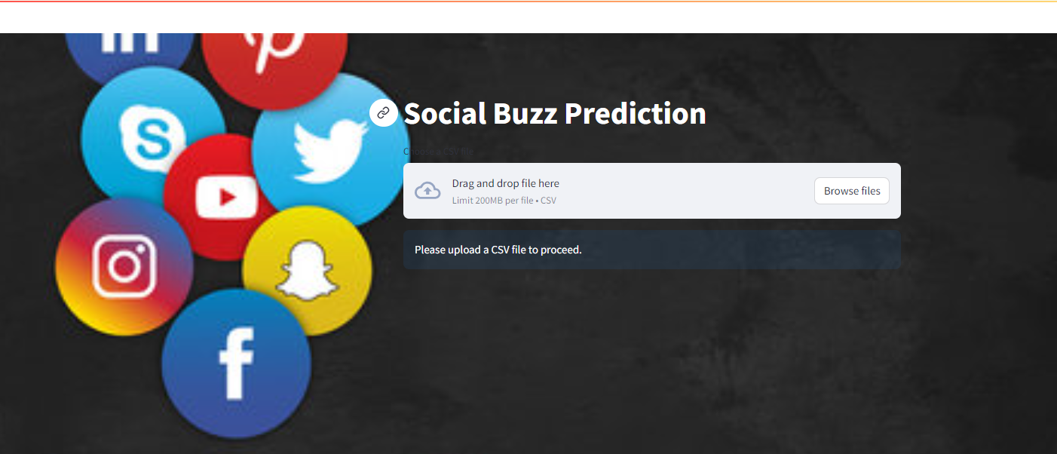
GUI Design And Functionality

Slide 29
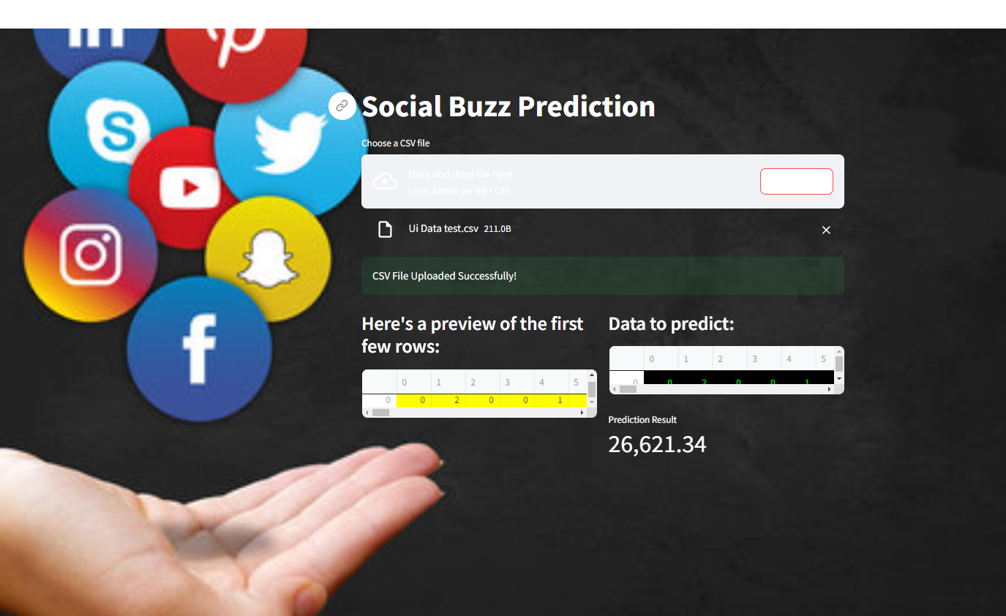
GUI Design And Functionality

Slide 30
Conclusion
Our project proposal aims to predict social media post virality using advanced machine learning techniques. By analyzing extensive data and leveraging various models, we seek to deepen understanding of engagement dynamics on social media. Our innovative approach includes novel feature engineering and combining multiple models to enhance predictive accuracy. The anticipated outcome is a tool for real-time virality prediction, offering valuable insights for optimizing social media content. This project promises to fill a gap in current knowledge and provide strategic advantages for content creators and marketers, marking a significant contribution to social media analytics.

Slide 31
THANK
YOU!!

